Slide 1
Entity and Aspect Extraction for Organizing News Comments
Source:CIKM’15
Advisor:Jia-Ling,Koh
Speaker:Chen-Wei,Hsu
Date:2017/04/11

Slide 2
Outline
Intorduction
Method
Experiment
Conclusion

Slide 3
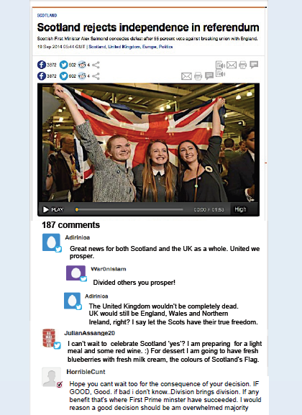
Introduction
Motivation
News websites give their users the opportunity to participate in discussions about published articles, by writing comments. Typically, these comments are unstructured making it hard to understand the flow of user discussions

Slide 4
Introduction
Goal
we propose an approach for entity and aspect extraction from user comments on news media platforms
gain more insights about news topics

Slide 5
Introduction
PROBLEM DEFINITION
Entity | Aspect
Scottish | Independence
UK | responsibilities

Slide 6
Method
Data preprocessing
first to filter the outcome of NER tools to have only entities of the types we have denfined
need to extract the context of each comment from its related comments and eventually from the news article itself
Notes:
利用NER工具處理，但是還是無法完全達到我們想要的結果 因此需要一些處理

Slide 7
Method
ENTITY EXTRACTION
Entity Filtering
defined an entity to be either a person, an organisation, a location, or any well-defined concept such as languages
exploiting a knowledge base to check whether a given noun phrase is an entity or not
Name Normalization
UK
United Kingdom

Slide 8
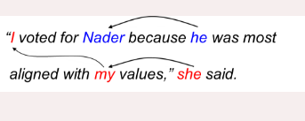
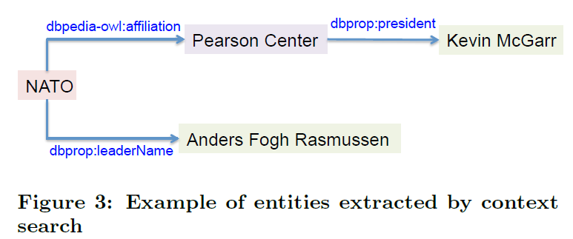
Method
ENTITY EXTRACTION
Coreference Resolution
Context-related Entity Search
extracting all explicit entities using a traditional NER tool and the name normalization technique

Slide 9
Method
ASPECT EXTRACTION
Explicit Aspect Extraction
Prepositional Dependency
Possessive Dependency

Slide 10
Method
ASPECT EXTRACTION
Explicit Aspect Extraction
Verb Dependency

Slide 11
Method
ASPECT EXTRACTION
Implicit Aspect Extraction
Adjective-to-aspect Mapping
Aspect: employer , back office , call centre operation

Slide 12
Method
Implicit Aspect Extraction
Lexical Adjective-to-aspect Mapping
 | similar
big | large
 | huge
 | great
wordnet

Slide 13
Method
ASPECT EXTRACTION
Semi-implicit Aspect Extraction
if an entity (1) has a dependency to a verb and (2) the verb is not related to an explicit or implicit aspect, then we convert the verb to a noun and use it as an aspect for the entity. The same thing applies for adjectives
Entity | aspect
Scots | honest
Scots | Honesty

Slide 14
Experiment
Dataset
10 different news articles from the Al Jazeera and CNN websites
selected the 100 longest comments
three different categories: Politics, Sport,and Techs

Slide 15
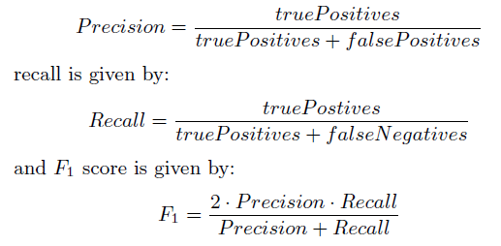
Experiment

Slide 16
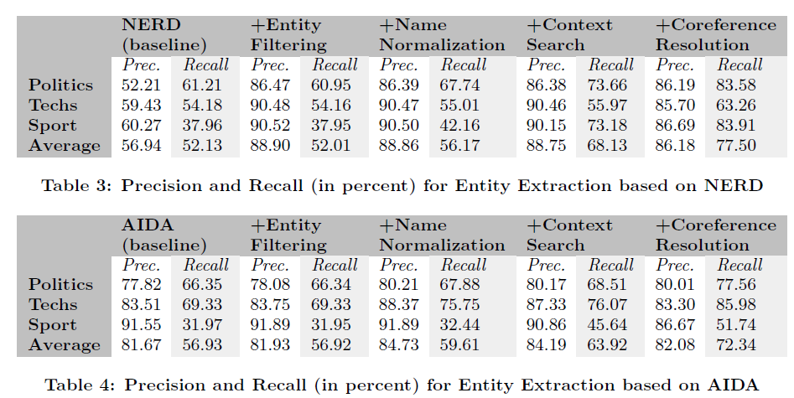
Experiment

Slide 17
Experiment

Slide 18
Conclusion
a new approach for entity and aspect extraction from user comments
In futurework, we aim at testing our approaches on larger datasets

